Slide 1



Validation of Primary Care Resource Use and Costs in OMOP-Mapped vs. Source CPRD Aurum Data
G. Fabiano, N. Njuki, X. Chen, A. Delmestri, R. Pinedo-Villanueva
University of Oxford, UK

Slide 2






Real-World Data
Evidence on effectiveness, safety, utilisation and economic aspects in real-world populations
Complement trial data
Increasingly accepted by regulatory agencies and HTA bodies
Notes:
Real-world data (RWD) come from diverse sources including electronic health records, administrative databases, registries, and patient-generated data.
RWD provide evidence on effectiveness, safety, and utilisation, offering insight into real-world clinical practice to complement trial data
RWD are increasingly used by regulatory agencies and HTA bodies to support decision-making.

Slide 3
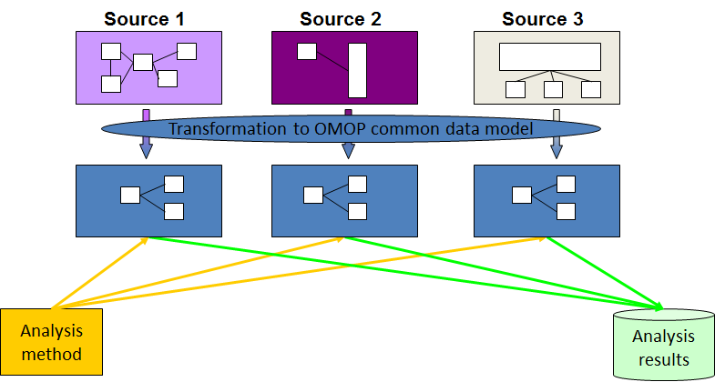



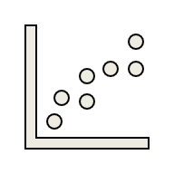
Local database
Analysis
Results
Data Transfer
Source 1
Data Transfer
Source 2
Data Transfer
Source 3
Notes:
RWD analyses typically require data access approval, individual-level data is transferred to the analyst, who then start understanding of data structure, data cleaning, and bespoke code development.
Different data sources often record the same information using different structure and terminology.
As a result, every time we want to replicate our analysis, our analytical code must be adapted or rewritten, creating a process that is slow, costly, and lacks transparency.

Slide 4

Local database
Analysis & Results
Query
Source 1
Common Data Model
Results
One analytical
code
Query
Data standardisation
Results
Source 2
Common Data Model
Query
Results
Source 3
Common Data Model
Notes:
Common Data Models (CDMs) address these issues by mapping datasets into a standardised shared structure and terminology.
CDMs enable federated analyses, where a single analytical code—written for the CDM—is executed locally by data partners.
The data remain on site; only aggregate results are shared.
This approach allows faster, more efficient, and more scalable analyses across multiple RWD sources.

Slide 5

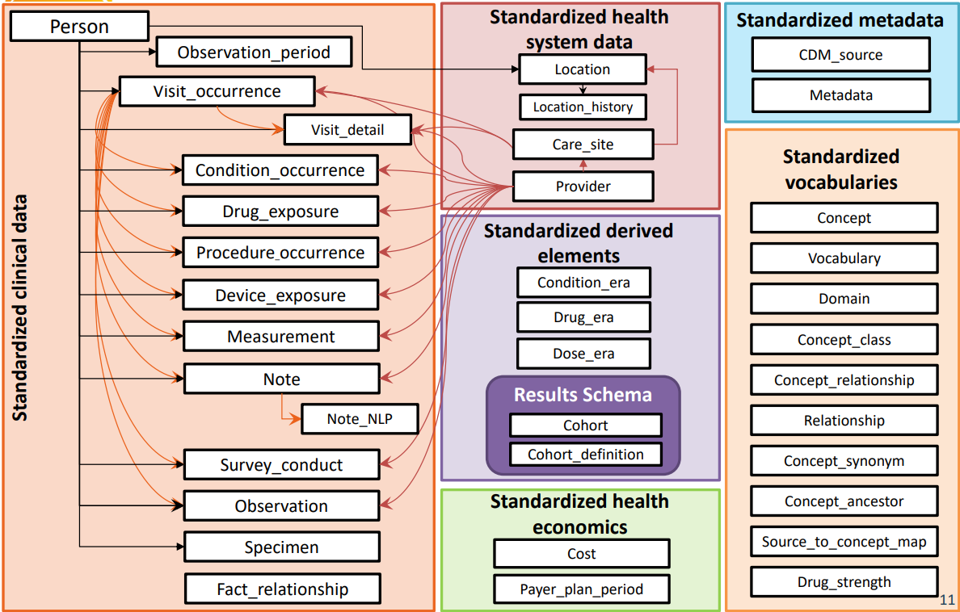
Observational Medical Outcomes Partnership (OMOP-CDM)
Notes:
The OMOP Common Data Model, developed by OHDSI in 2014, provides both syntactic interoperability (common data tables, for example demographics and clinical events) and semantic interoperability (standardised vocabularies).
Also, the original source variables are retained for traceability.
OMOP includes a health economics table, however administrative data in Europe typically do not contain direct cost information.

Slide 6

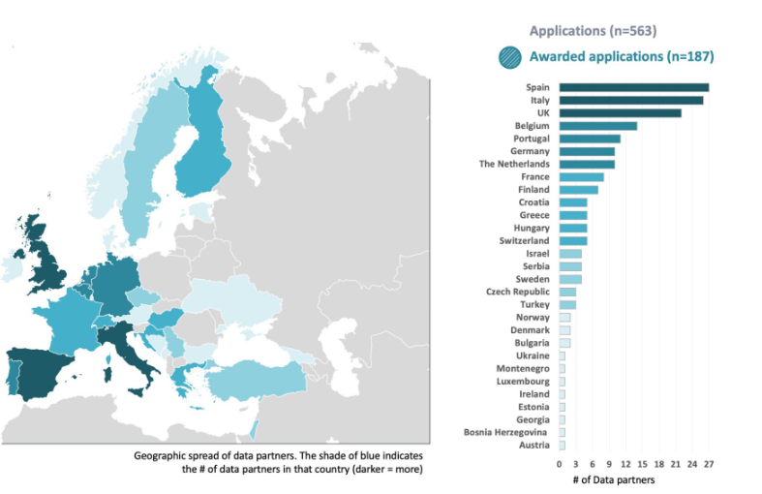
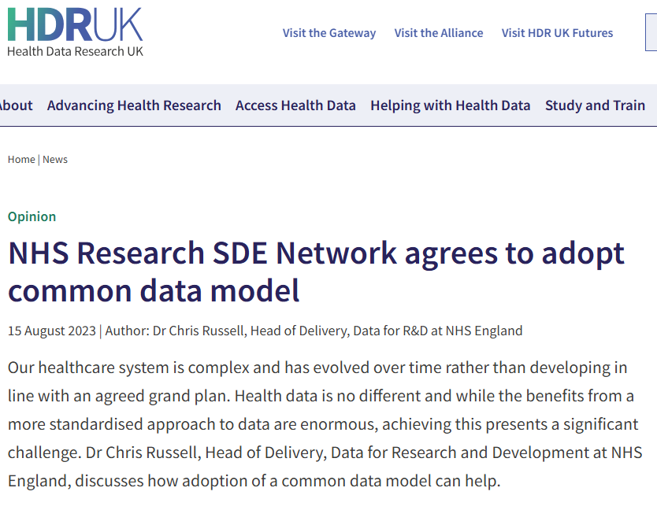
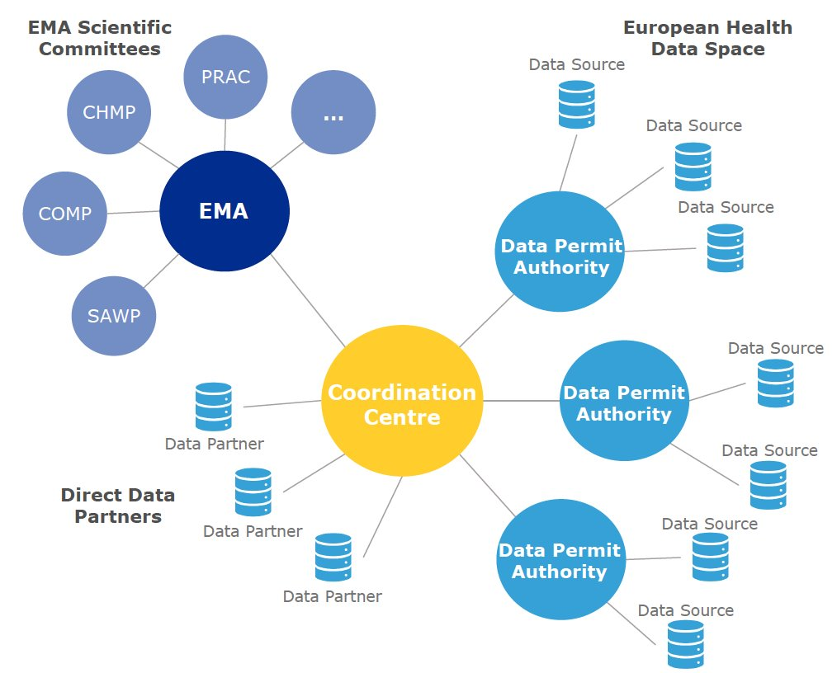

29 European countries
~850 million records being mapped to OMOP CDM
Notes:
OMOP is widely adopted across Europe and the UK.
For example, the EHDEN initiative mapped over 850 million records from 29 countries to OMOP.
The DARWIN EU network uses OMOP to generate reliable real-world evidence for regulators.
The NHS in England is also adopting OMOP for its Secure Data Environment.
So far, OMOP has enabled rapid, high-quality evidence generation, especially during COVID-19.
However, most studies are in the field of pharmacoepidemiology and health economics applications remain underdeveloped.

Slide 7
OBJECTIVE
To compare HCRU and costs calculated in OMOP-mapped against estimates from the corresponding CPRD-source dataset
Notes:
This study is part of our broader effort by our team to implement OMOP-based RWD analyses.
Last year, we conducted multi-country distributed analyses estimating healthcare resource use (HCRU) and costs in primary and secondary care in six European countries.
Before scaling up to wider health economics applications, we need to confirm that OMOP-mapped data yield accurate estimates and that nothing is “lost in translation”.
Here, we focus on the UK and compare primary care HCRU and costs derived from OMOP-mapped CPRD data versus the original source dataset to assess how accurate these estimates are

Slide 8
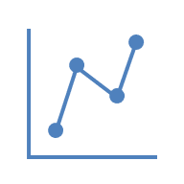




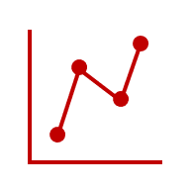
METHODS
2010-2018
OMOP
Compare means and CIs from bootstrap samples
≥50
years
Retrospective cohort study
Women with a first ever fragility fracture
CPRD
Primary care
encounters
Analyse HCRU and Costs
730-day follow-up
Notes:
Retrospective cohort study of women with a first fragility fracture.
We examined primary care encounters, focusing on frequency and specialty of provider (e.g. GP, nurse).
Two-year follow-up.
Comparison of results between source CPRD data and OMOP-mapped data.

Slide 9
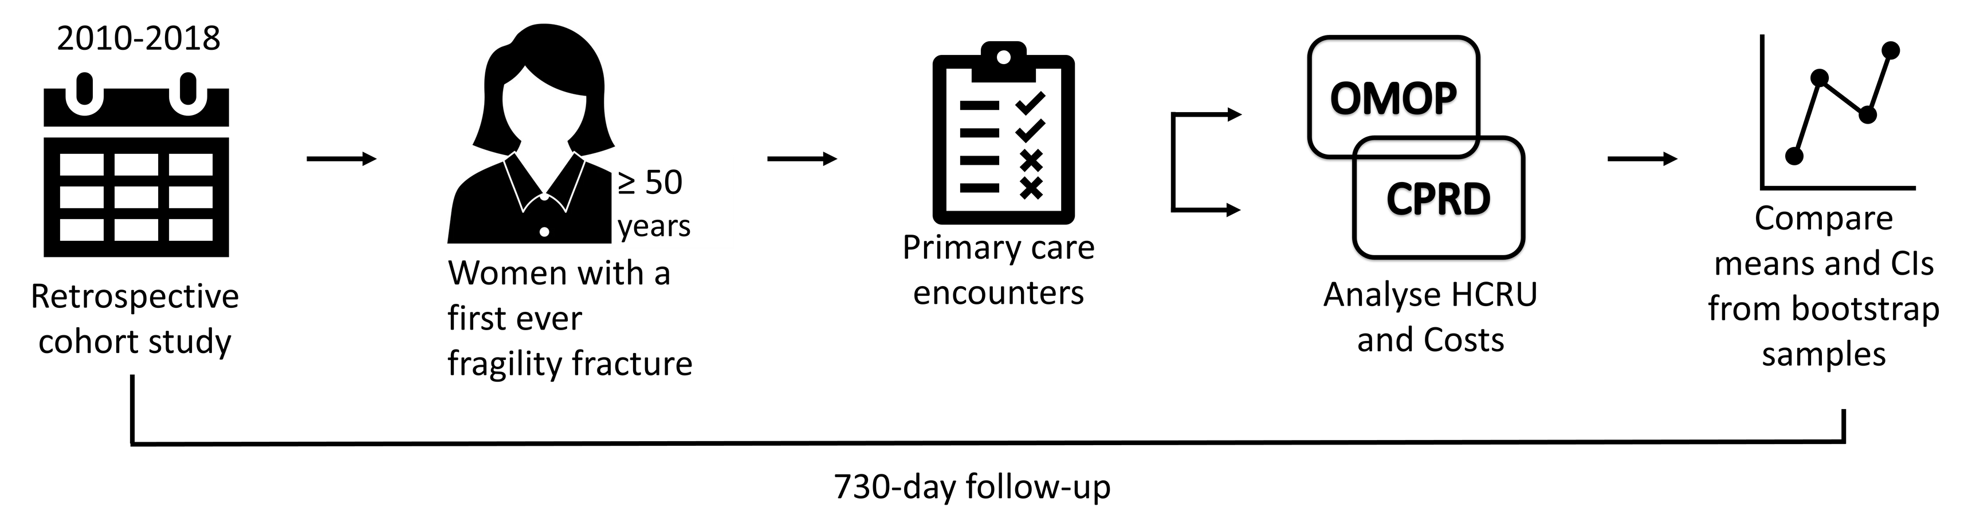
RESULTS
COHORT
AGE in years (mean, SD)
FRACTURE SITE
Source-CPRD: 71.3 (12.2)
OMOP: 71.3 (12.2)
23,106
22,900
HEALTHCARE USERS
Source-CPRD: 97.3%
OMOP: 97.4%

Slide 10
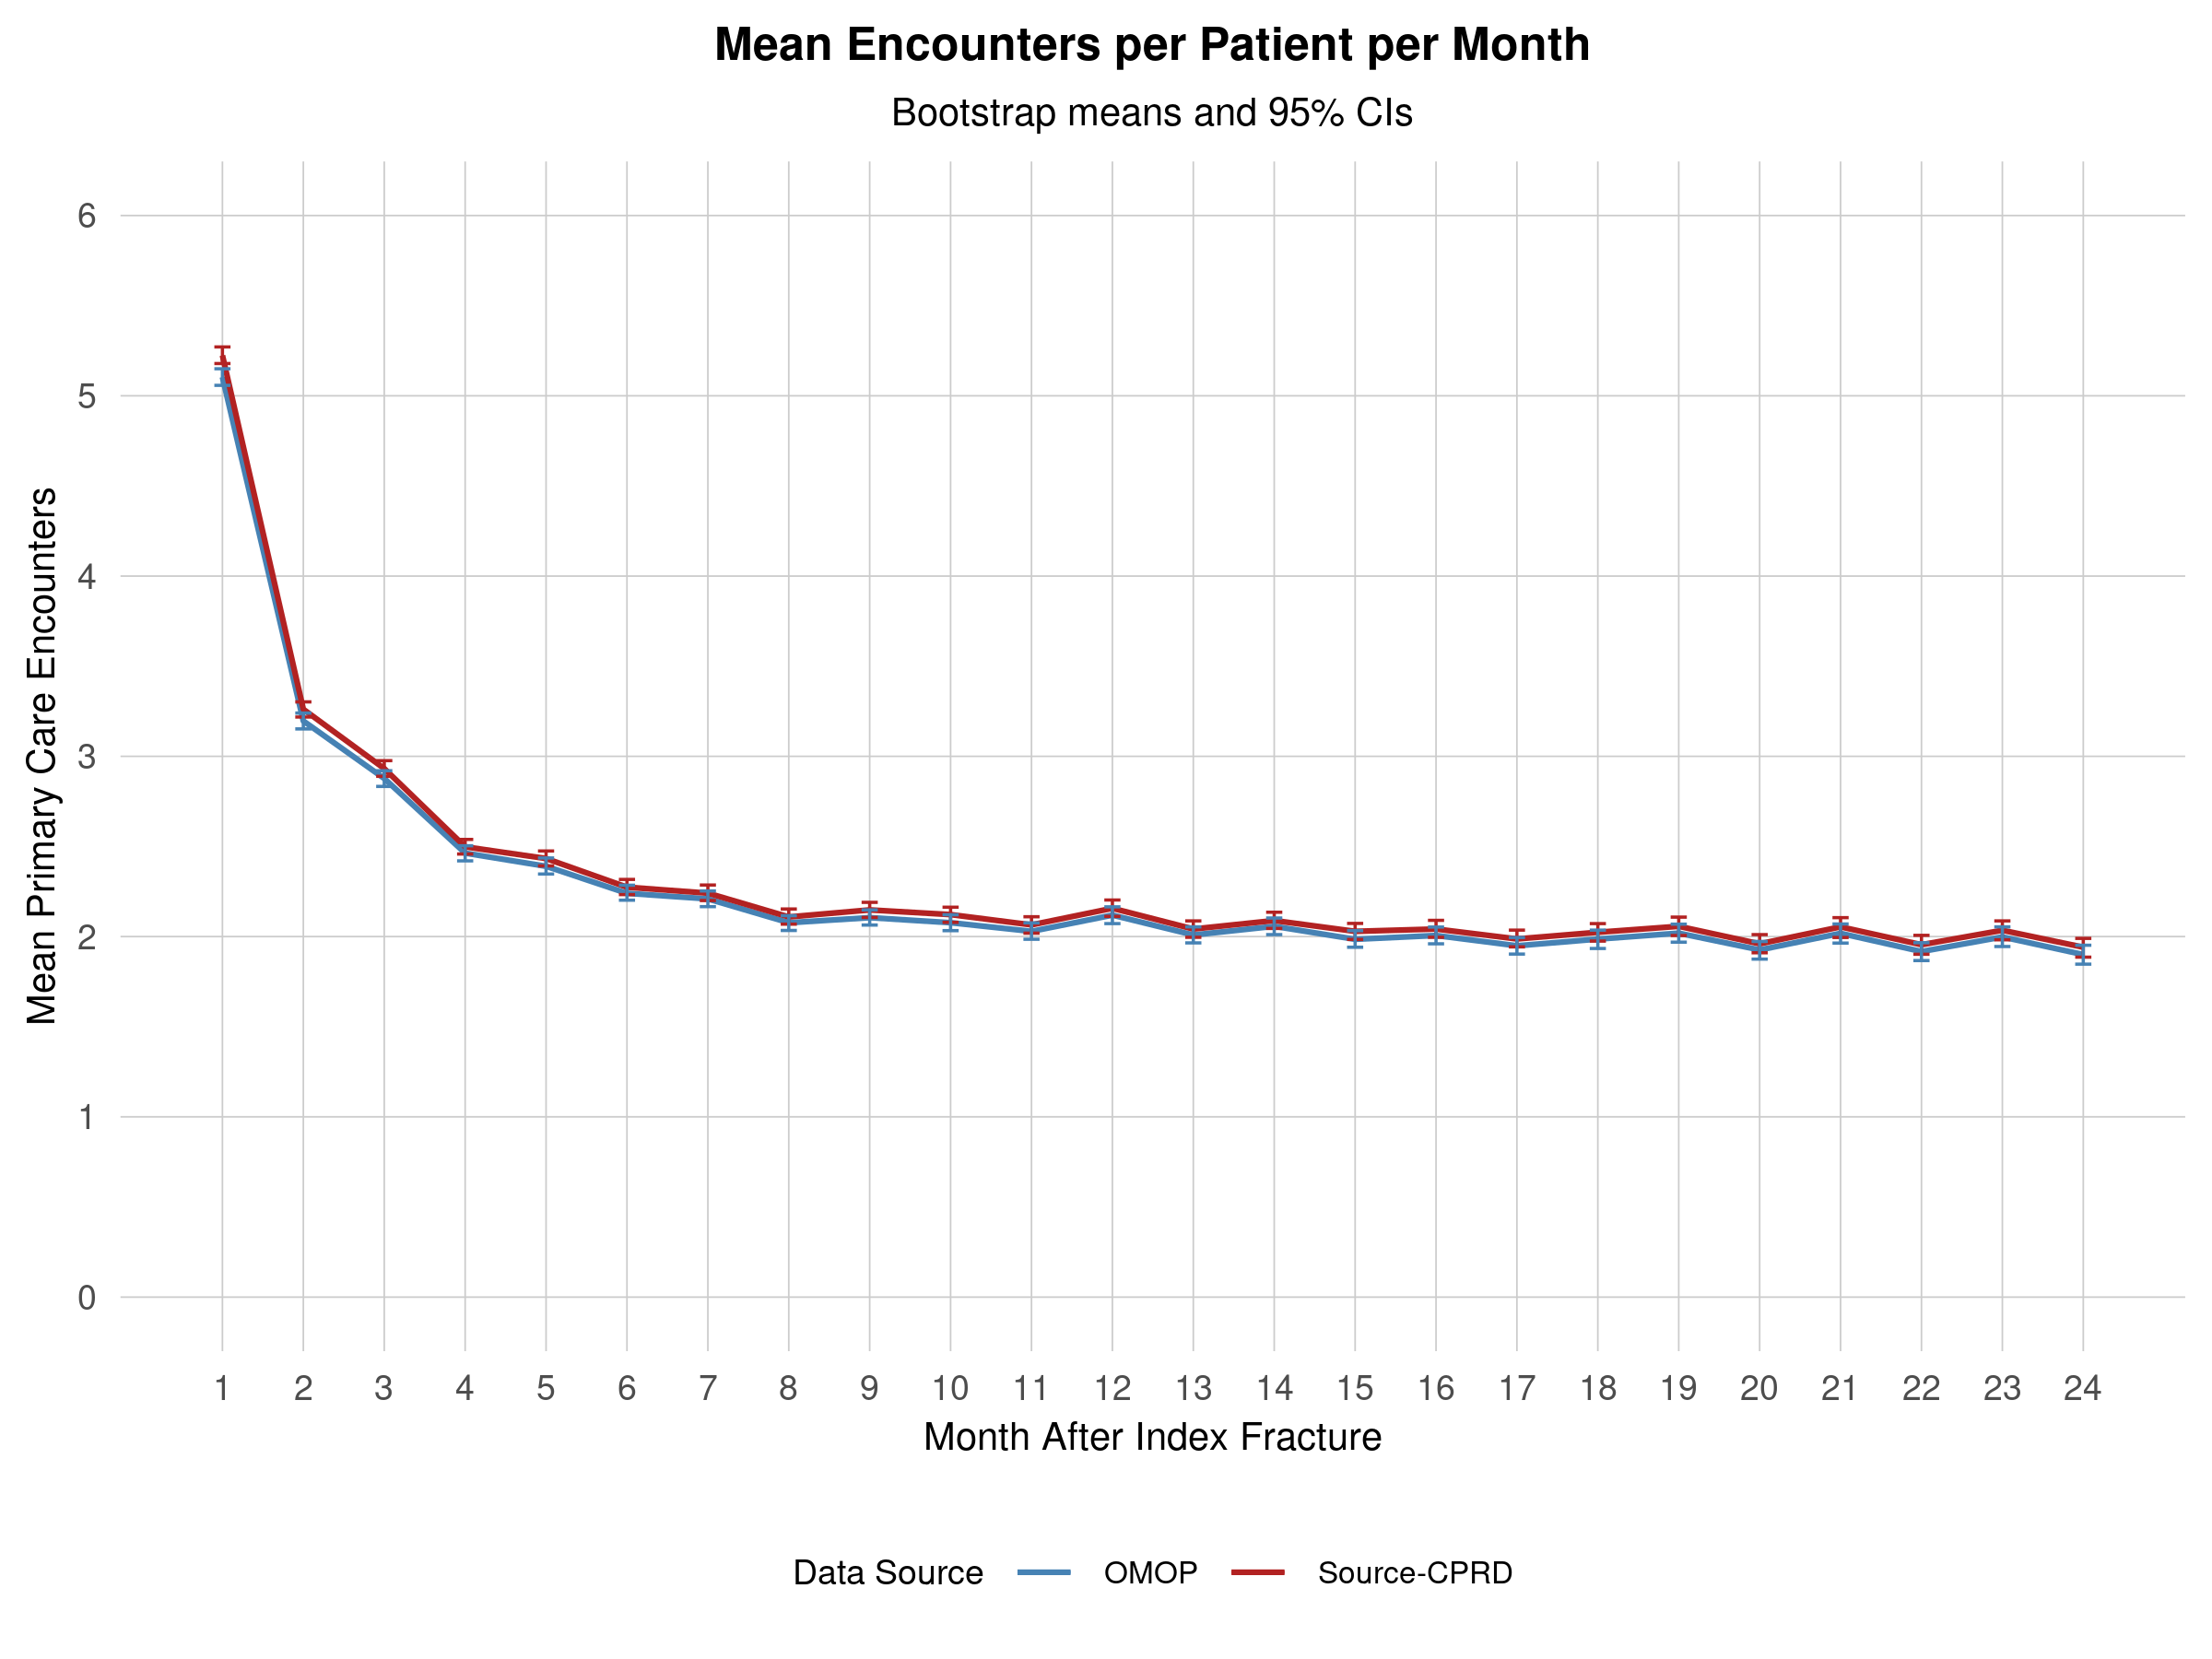
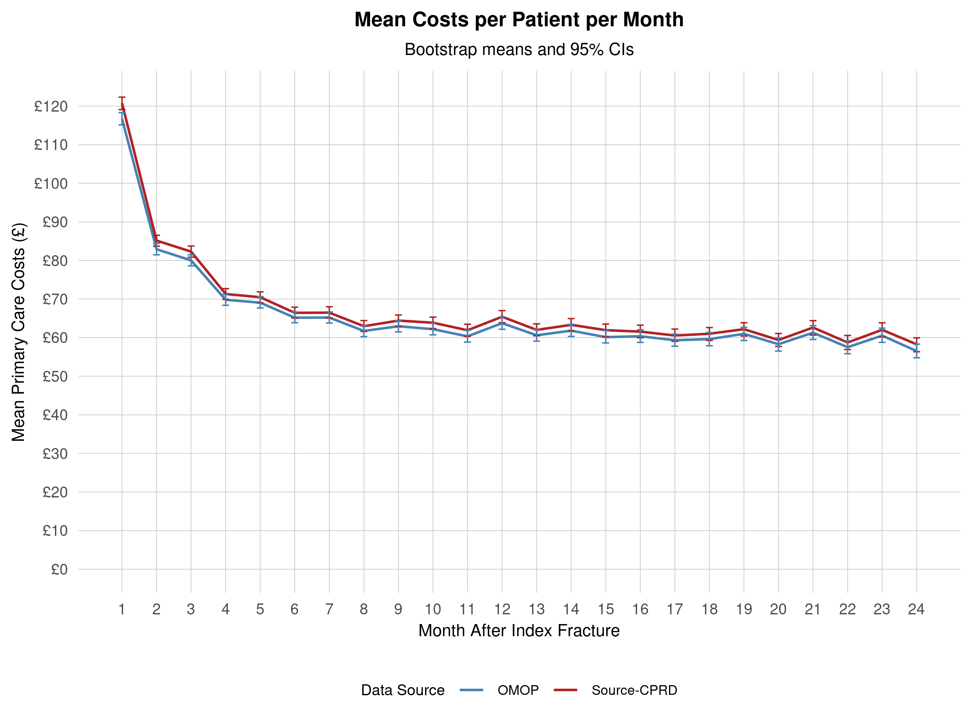
RESULTS: HCRU and Costs
Data Source
Source-CPRD
OMOP

Slide 11
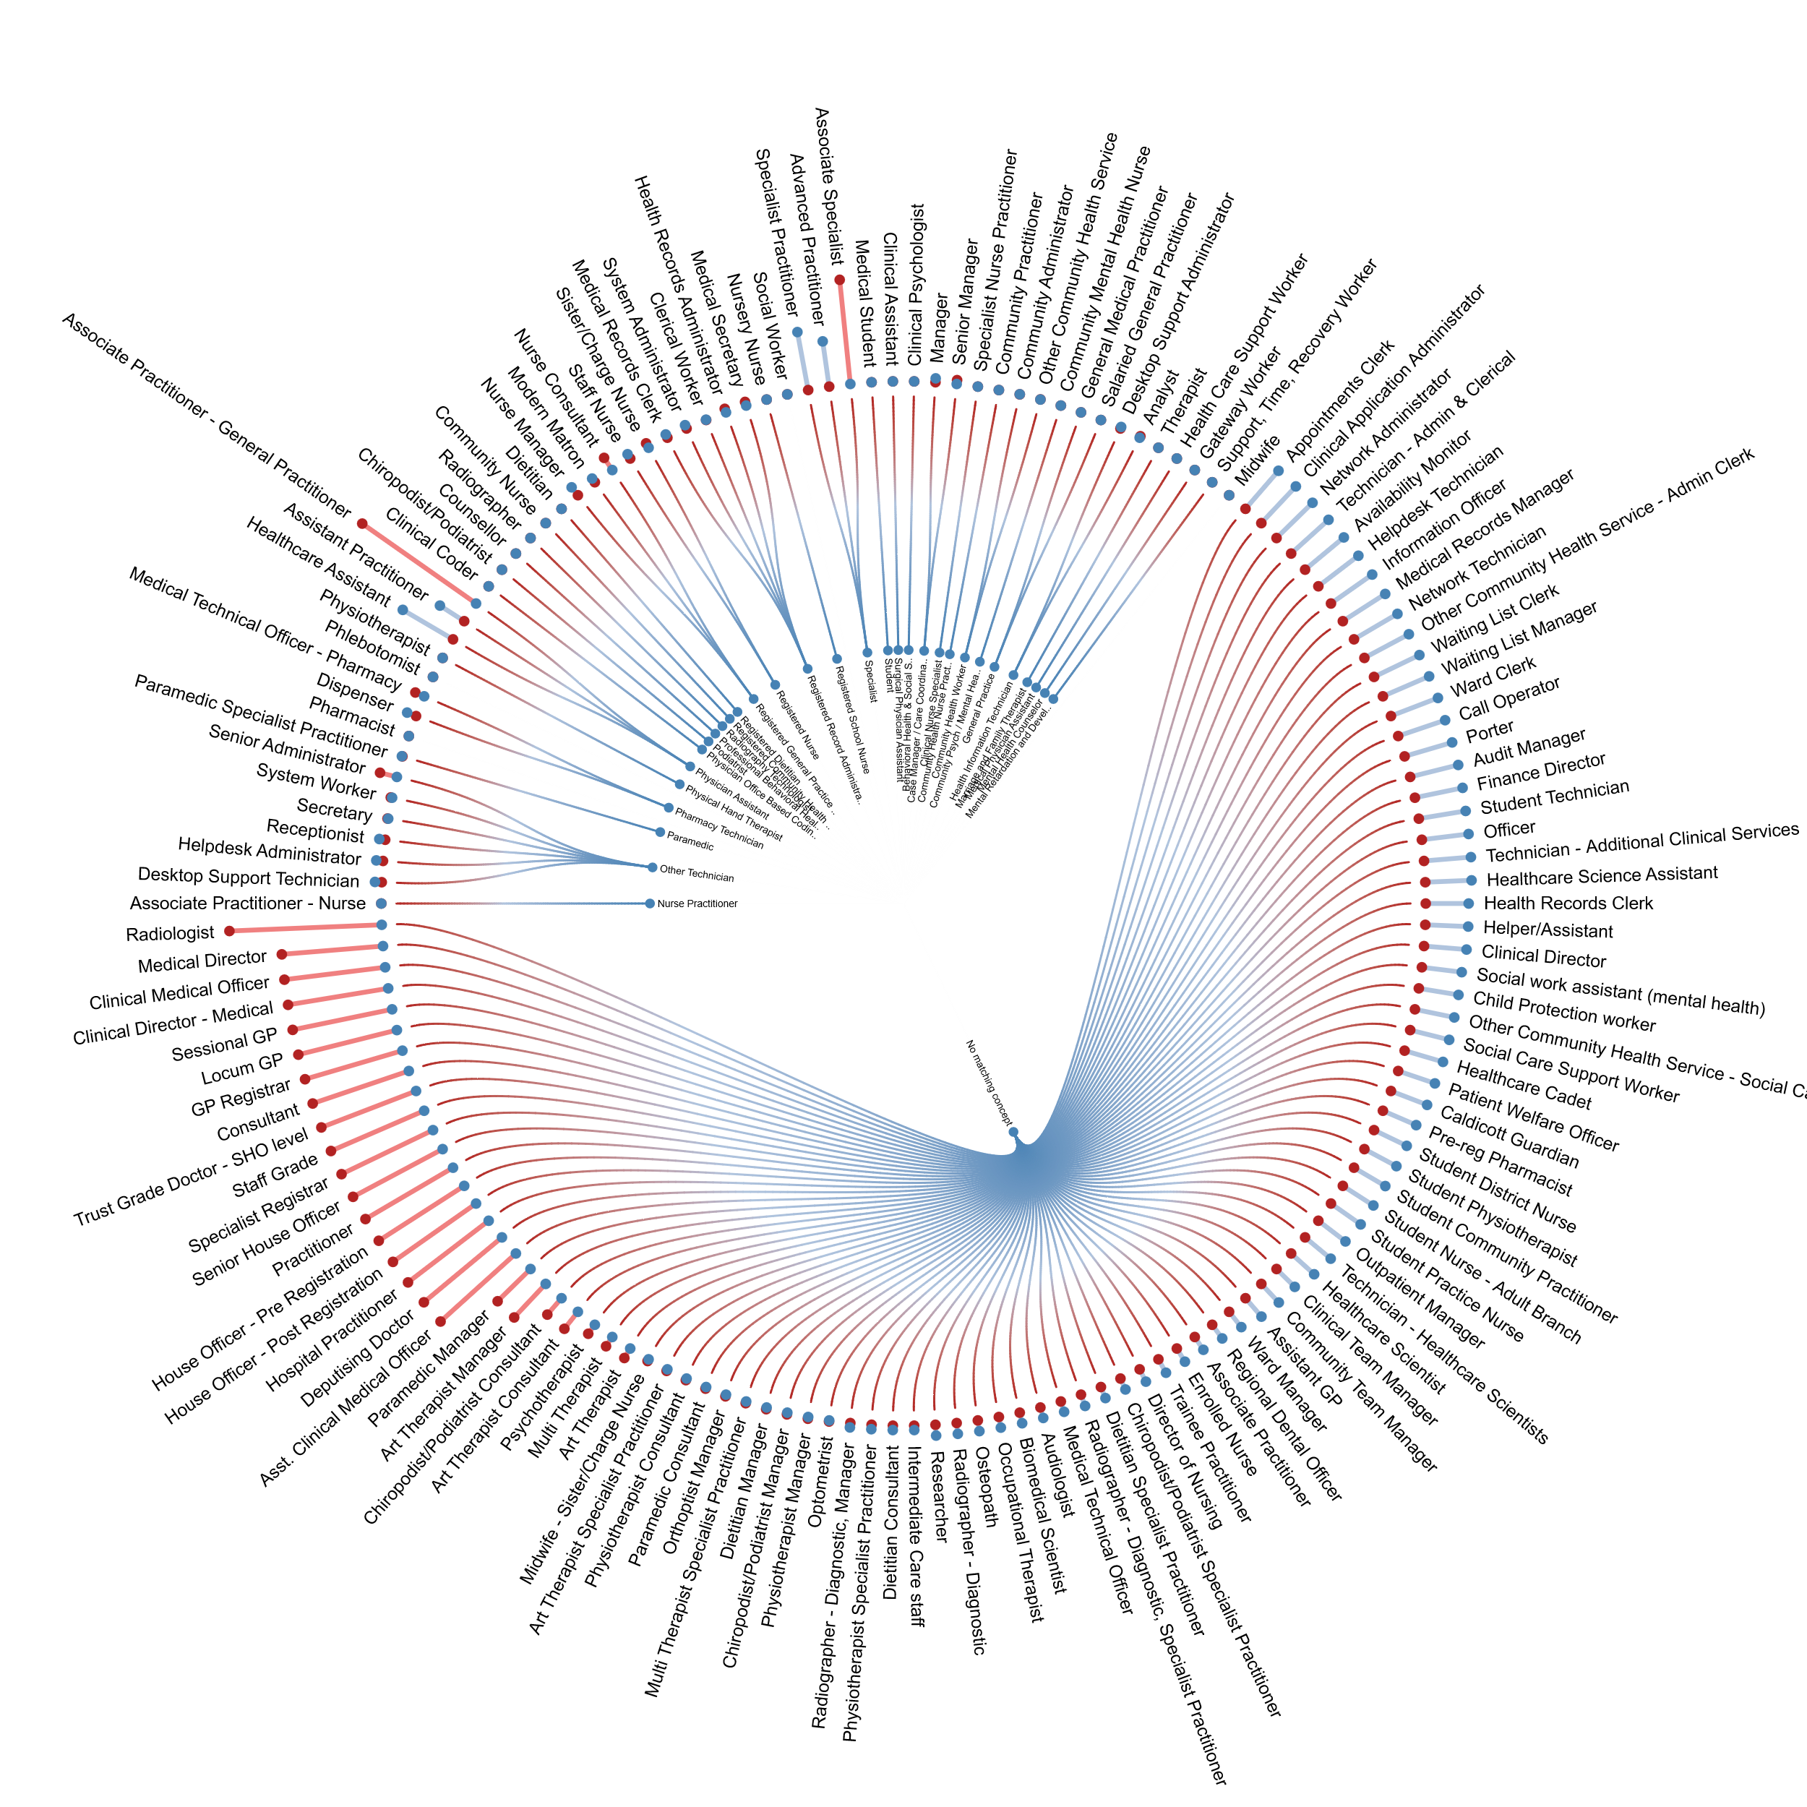
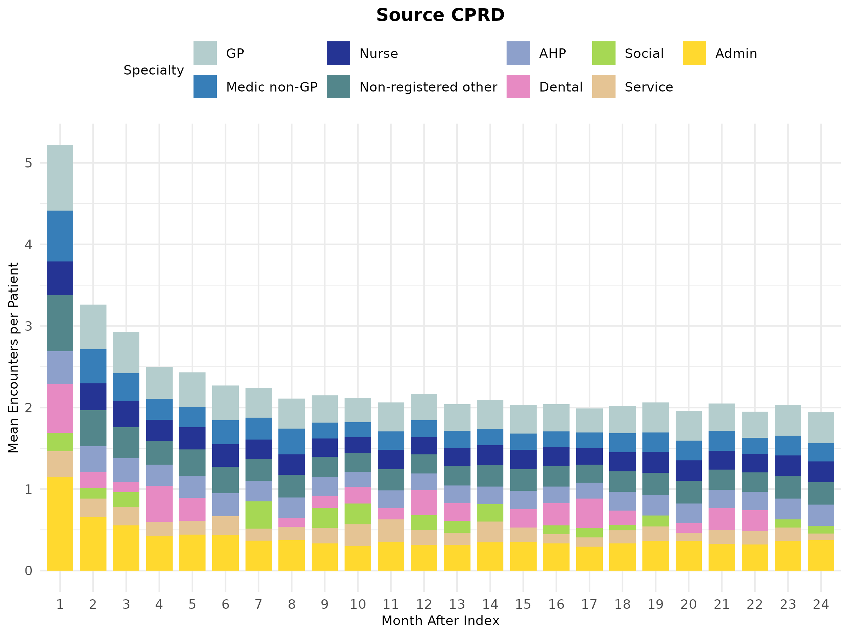
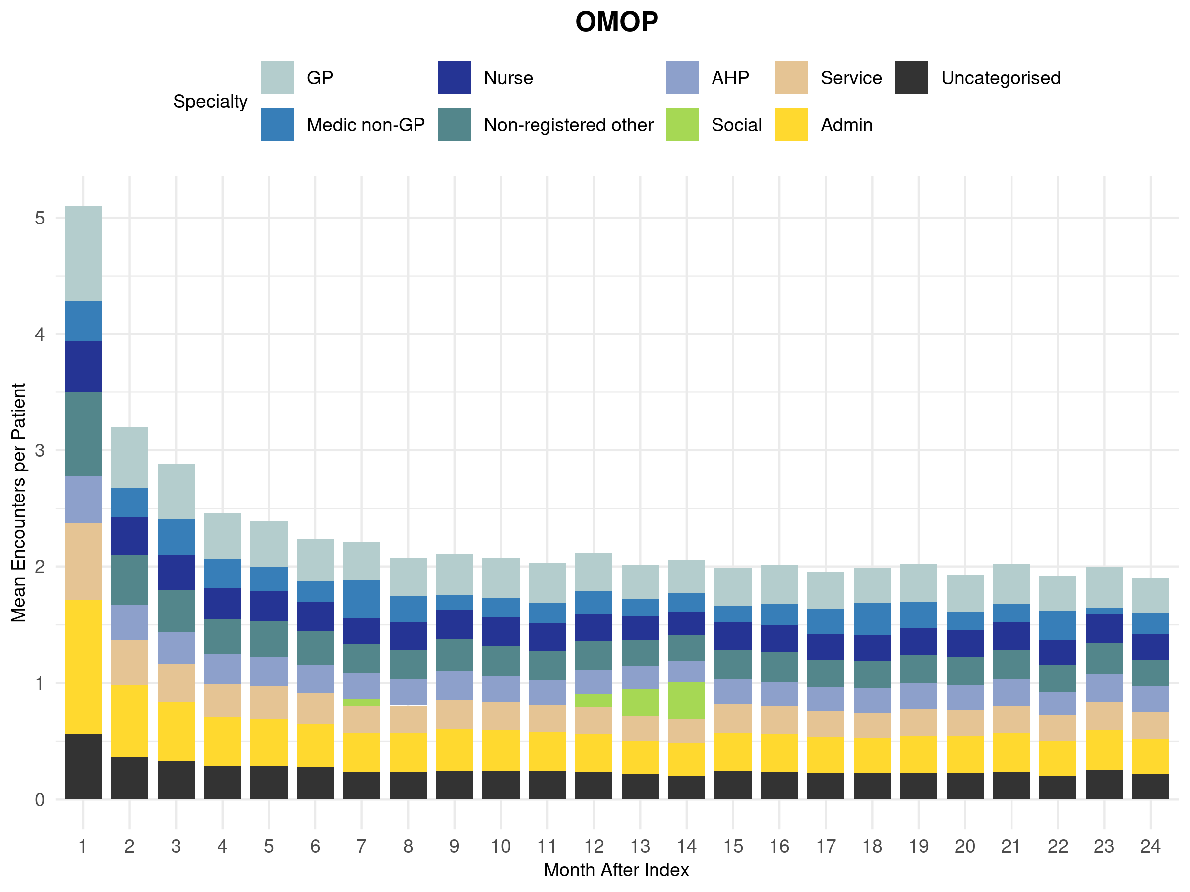
Source-CPRD
OMOP
Source-CPRD
OMOP
Notes:
Outer circle source CPRD spelcialty
Inner circle OMOP standard specialties

Slide 12
CONCLUSIONS
OMOP-mapped estimates of primary care resource use and costs were equivalent to those obtained from source-CPRD dataset
(Minor) differences were observed in:
  Cohort composition due to mapping quality standards
  Specialty classifications
Differences can be minimised with refinements to mapping and vocabularies
Federated analyses using OMOP mapped data appears to be a reliable method to accurately capture HCRU and costs in CPRD-UK.
Notes:
- We are currently refining mappings for clinical specialties lacking standard equivalents and have identified existing OMOP codes that can be implemented—an easier improvement than expanding vocabularies.
- Overall, CDMs enhance transparency, speed, and reproducibility of health economic analyses, supporting more efficient evidence generation from RWD.

